Slide 1

Group 2 Project Presentation
The Home Sale Prices of Single Family Residential and Condominiums in Alameda and Santa Clara Counties
By: N S Srivalli Chadalavada, Alina Gurung, Palak Patel, Yvonne Halm
May 11, 2022

Slide 2

Introduction

Slide 3
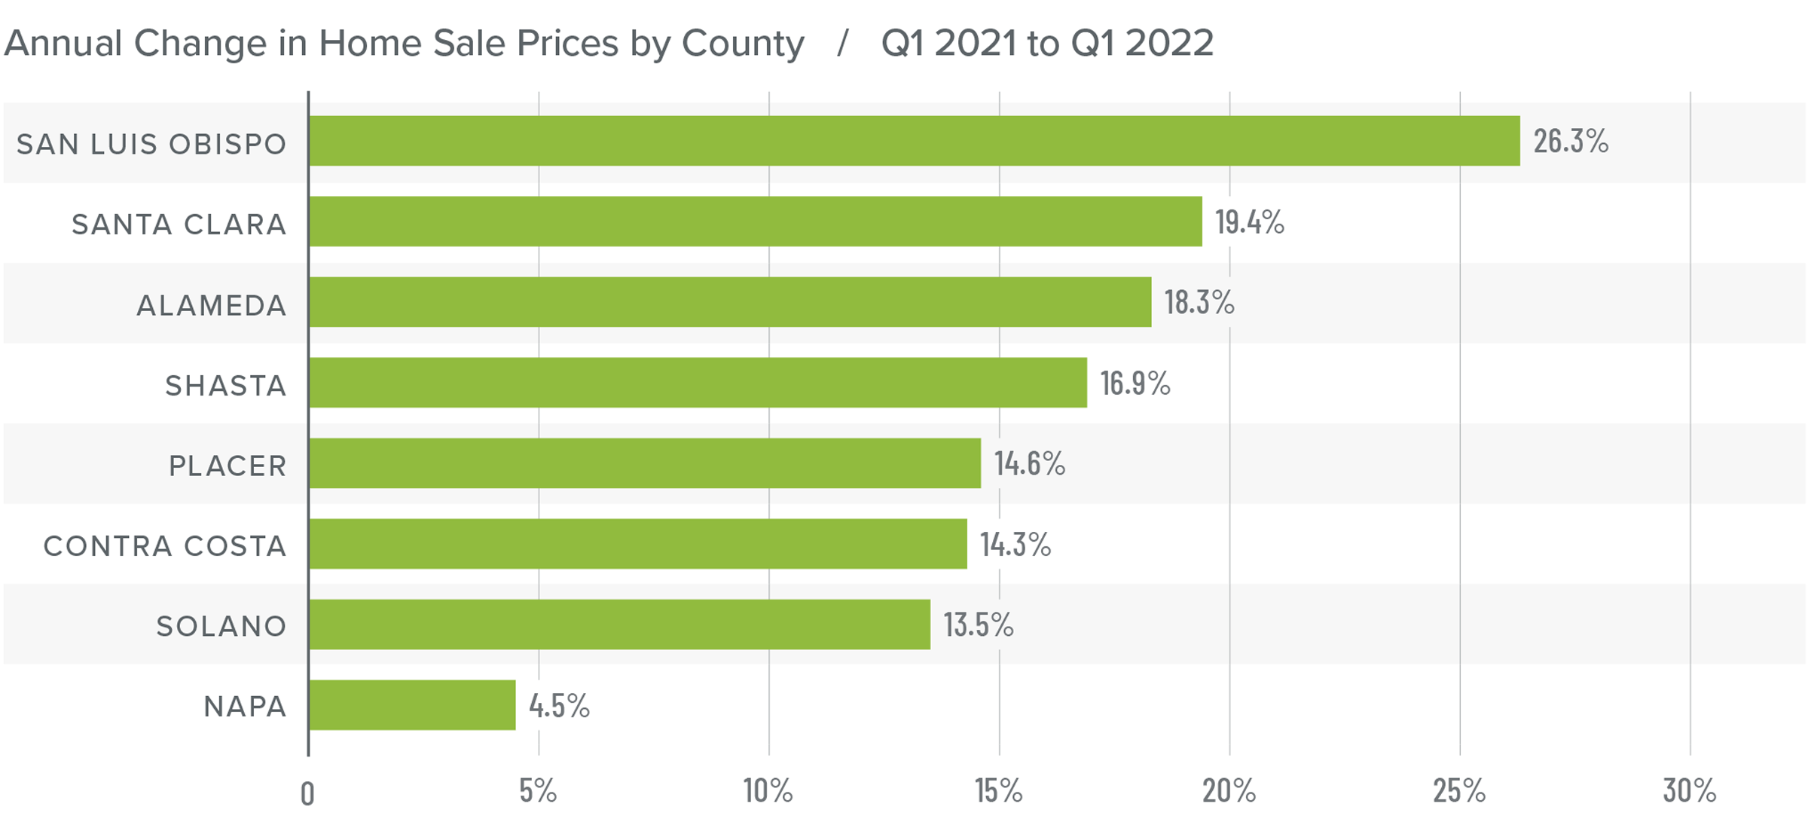
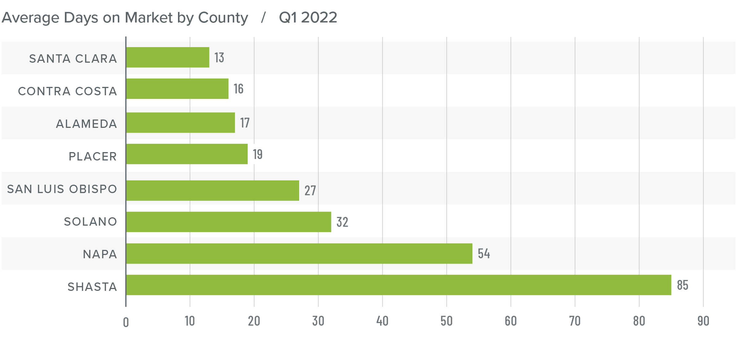
Real Estate Market – Northern California
The booming housing market has helped the U.S. economy come back from the financial and economic impacts of the COVID-19 pandemic. Home prices have appreciated.
According to the Gardner Report^{[1]}, the annual average home price (Q1 of 2021 and 2022) in northern California rose by 17.2%. Santa Clara and Alameda counties rose by 19.4% and 18.3%, respectively. Santa Clara county was one of the most expensive market.
In addition, the number of days of homes listed has dropped.
Economists attribute this to low inventory and a high demand for homes coupled with rise in inflation.
Source: ^{[1]}https://www.windermere.com/market-update/northern-california?msclkid=43ea6dabd00f11ecb9af0acb0adea8fd

Slide 4

Objective
To assess the effect of attributes of a home and amenities in the community on its sale price across Alameda and Santa Clara counties.
Do the attributes have any relationship with the list price? If yes, how they are correlated with list price?
Do any of the attributes are correlated with each other?
How is the list price varying with living square footage area across Almeda and Santa Clara County? For eg: we want to find out which county has lower home prices with same living square footage area.
How is the median list price per sqft varying with living square footage area across the cities? For eg: we want to find out which city has lower home prices with same living square footage area.
Do the high rated schools in cities impact list price?
Does amenities impact the list price?
Model development for making predictions

Slide 5

ADOPTED METHODS
Data Collection: Scraping in python using BeautifulSoup from REDFIN website.
Data Cleaning: Removed Null values and dropped irrelevant columns, changed data types of certain columns. Outliers are not dealt in this analysis.
Exploratory Data Analysis: Conducted Data Analysis to answer research questions.
Model Development : Developed Multiple Linear Regression Model for predictions.
ASSUMPTIONS
Only the houses and condos are used in this analysis.
Only the outliers for Bedrooms are removed. Dealt with only houses with less than or equal to 7 beds.

Slide 6
Attributes
List Price :- A list price is the price of a home for sale set by a seller and listing agent. The unit of list price is ‘$’.
Address, City, State, Zip code :- These variables gives the exact location of advertised property. Zip code is the postal code used by state postal.
Property URL:- The links or URLs of all the properties in cities of 2 Counties.
Beds:- the total number of Bedrooms available in the advertised property.
Baths :- the total number of Bathrooms available in the advertised property.
Living sqft :- Refers to the “living area” of the home. It is the area that will be heated or cooled.
Status :- It signifies whether the property is active, pending or sold out.
Property Type :- It marks the type of advertised property such as Condo, Single, Double etc..
Year Built :- It implies the year in which the advertised property was built.
Est. Monthly Payment :- It is the amount you pay back in your home loan every month. It consists of Principal and interest, property taxes and Homeowner’s insurance.
Price per Square Feet :- This is the list or sale price of a home divided by the number of total square feet. It determines how much a buyer will pay for a square foot of space.
Drought Score :- This score is made up of three parts on a scale of 100: sensitivity, exposure, and ability to adapt. Provides information on climate risk to location of property.
Walk Score :- It measures the walkability of any address using a patented system. Amenities within 5 minutes of distance are given maximum points.
Neighbourhood Homes :- It is the number of total houses sold near the advertised property.
Transit Score :- Transit score implies about the facility of public transportation option and how far it is from the advertised property.
Groceries Stores :- It shows the total number of grocery stores nearby the advertised property.
Services :- It shows the number of services available nearby the advertised property. It includes pre-school, fuel station, hair salon, nail salon, etc.
Emergency :- It shows the number of Emergency services available nearby the advertised property. It includes Fire station, Police department and Hospital.
Shopping :- It shows the total number of shopping mall, drug store and convenience store are available nearby the advertised property. It includes Safeway, 7-Eleven.
Food and Drink :- It shows the number of refreshment shops/ lounges are available nearby the advertised property. It includes Hotel Bar, Coffee shop, Restaurants, etc.

Slide 7
Attributes
Number of Schools :- It is number of schools located in the neighbourhood of advertised property. (Scraped Schools in a dictionary with school names and ratings) and separated as No. of Schools and Average rating for analysis)
Average rating :- The average rating of the schools located in the neighbourhood of advertised property..
County :- It shows in which county the address of advertised property is located. We are analysing two Counties, i.e., Santa Clara and Alameda.
Competitive Score:- Market Competition calculated over past 6 months on a scale of 100.
has_supercenter: Whether the advertised property have at least one supermarket in the supercenter list {Walmart, Target, …} located in the neighbourhood. If it has at least one takes the values of 1, otherwise 0.
has_starbucks: Whether the advertised property have at least one starbucks located in the neighbourhood. If it has at least one takes the values of 1, otherwise 0.
has_boba: Whether the house have at least boba shop located in the neighbourhood. If it has at least one takes the values of 1, otherwise. 0
has_mall: Whether the house have at least mall located in the neighbourhood. If it has at least one takes the values of 1, otherwise 0.
has_indian_restaurant: Whether the house have at least an Indian restaurant located in the neighbourhood. If it has at least one takes the values of 1, otherwise 0.
has_major_indian_grocery: Whether the house have at least an Indian grocery located in the neighbourhood. If it has at least one takes the values of 1, otherwise 0.
has_chinese_restaurant: Whether the house have at least a Chinese restaurant located in the neighbourhood. If it has at least one takes the values of 1, otherwise 0.
has_mexican_restaurant: Whether the house have at least a Mexican restaurant located in the neighbourhood. If it has at least one takes the values of 1, otherwise 0.
page_fav_count_30: The number of times this home has been favorited on Redfin for the current MLS listing from past 30 days.
page_fav_all_time_count: The number of times this home has been favorited on Redfin for the current MLS listing overall.
page_view_count: The number of views the current MLS listing has had on the Redfin website since it was imported from the MLS.
Time on Redin: The advertised property’s time on redfin since it Is listed on the Redfin website.
HOA Dues: Homeowners association fees are monthly dues collected by homeowners associations from property owners. These fees are standard for most purchased condominiums, apartments, and planned communities.
has_major_entertainment:- Whether the house have at least a theatre located in the neighbourhood. If it has at least one takes the values of 1, otherwise 0.
has_healthcare_support:- Whether the house have at least a health care support center or a hospital located in the neighbourhood. If it has at least one takes the values of 1, otherwise 0

Slide 8
IP blocking : Blocking is triggered when the server detects a large number of requests from the same IP address or when a search robot makes several parallel requests.
Captcha: CAPTCHA allows distinguishing a person from a robot.
Slow or unstable load speed: Websites may be slow to load content or may not load at all when receiving a large number of access requests. In such a situation, you can refresh the page and wait for the site to recover. However, the parser will not know how to handle such a situation and data collection may be interrupted.
How we overcame
Set a real User Agent: The User Agent (UA) is a string in the request header that specifies the browser and operating system for the web server. If your user agent does not belong to one of the major browsers, some sites will block its requests. (Mozilla browser)
Set random intervals in between your requests: Do not overload the site with a large number of requests. It is better to make a time delay of a few seconds between requests. We saved the URLs of the scanned pages so that we don’t have to come back to them again.
Don’t scrape during peak hours: It is better to collect data from sites during off-peak periods, so as not to interfere with the site work. It also plays a big role for the parser itself, as it will significantly increase the speed of data collection.
Challenges in Scraping
Notes:
Same tag and class name being used for different attributes. Became
difficult to extract data individually.

Slide 9
Process
List of City URLs of Alameda and Santa Clara County
Initial list of cities with first webpage of each city
Extracted all webpages of each city (used ‘a href’ tags)
Used BeautifulSoup to find the number of webpages and added all to the main URL list. Extracted all webpages of each city. We saved the URLs of the scanned pages so that we don’t have to come back to them again.
Extracted all URLs of each property (used ‘a href’ tags)
Used BeautifulSoup to scrape the property URLs and added all to the property URL list. We saved the URLs of the properties so that we don’t have to come back to them again.
Extracted information out of each property
Defined function that extracts all the information of attributes (using different relevant tags like ‘div’, ‘span’, ‘tspan’ etc.) and return a dictionary of attributes with corresponding values of single URL
Data Cleaning and Dimension reduction
Identified the null values, irrelevant attributes, correlated attributes, noisy data and cleaned the data
Exported to CSV and Data is ready for analysis!
Used try & except blocks to handle errors and inserted nan values to those rows where there are exceptions.
Created a data frame with the required attributes
Called the function while Iterating through the URLs and adding the returned dictionary to the last row of the data frame
Write the data frame to the csv
2864 property urls

Slide 10
Analysis and Results

Slide 11
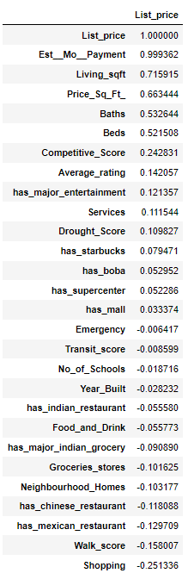
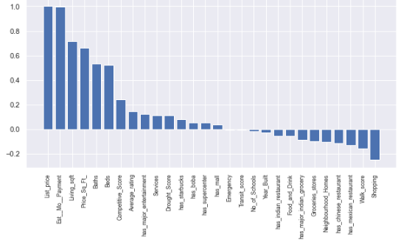
1. Attributes’ relationship with the list price

Slide 12
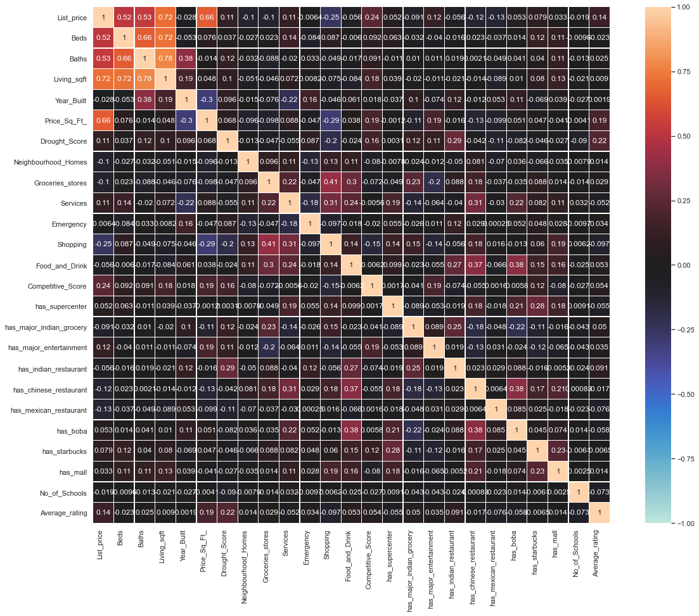
2. Attributes’ correlation with each other
Price is correlated more with Sqft followed by Bath and Beds.
'Groceries_stores', 'Shopping', 'Food_and_Drink', 'Services’ columns are dropped because these are correlated to other attributes.

Slide 13
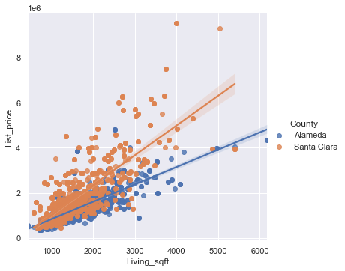
3. Variation of List price with Living sqft- County wise
Santa Clara County has more prices for the same area compared to Alameda County.
In both counties,the more the living sqft the higher the house prices.
Notes:
Add median pricing infrmation

Slide 14
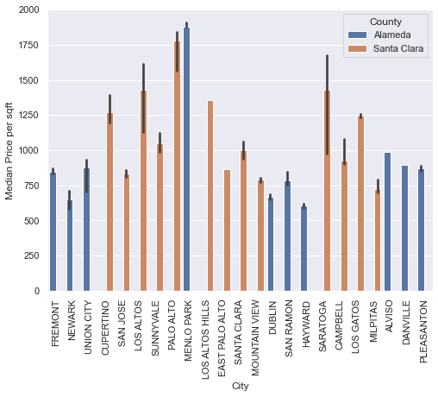
4. Variation of Median price per sqft across the cities
Palo Alto, Saratoga, Los Altos, Los Altos Hills, Cupertino, Los Gatos cities are having high median home price per sqft.
Notes:
Probably Menlo Park has facebook, Cupertino has Apple, Palo Alto has Stanford and hubs for start ups.

Slide 15
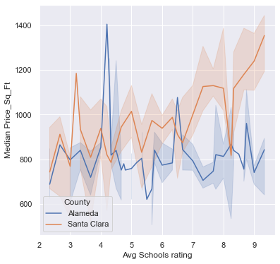
Do the high rated schools in cities impact Median price per sqft across the counties?
With increase in Average schools rating the median price per sqft increases for Santa Clara County.
Clearly from the graph, high rated schools are influencing the home prices in Santa Clara County.
In Alameda County, median price per sqft did not indicate any trend with Average schools rating.
Notes:
Household income is higher for Santa Clara county.

Slide 16
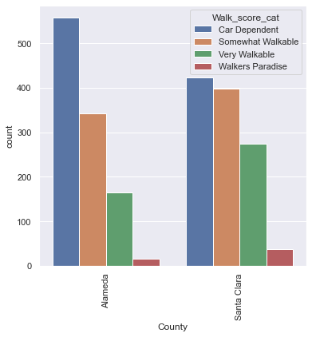
Variation of Count of walk Score categories across the counties
The Alameda county has more Car dependency compared to Santa Clara County.
From the plot, it is inferred the ease of availability of resources is more in Santa Clara County compared to Alameda County.

Slide 17
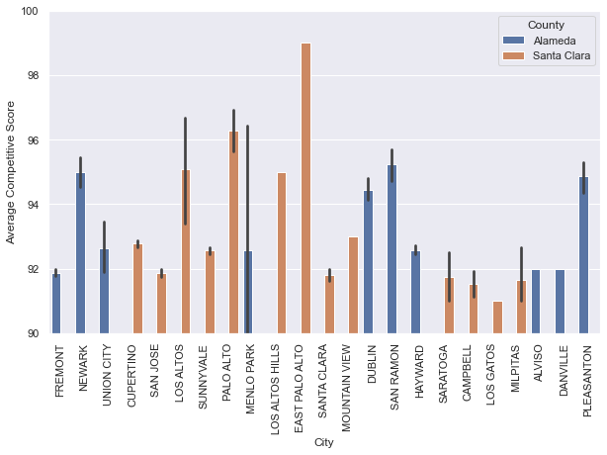
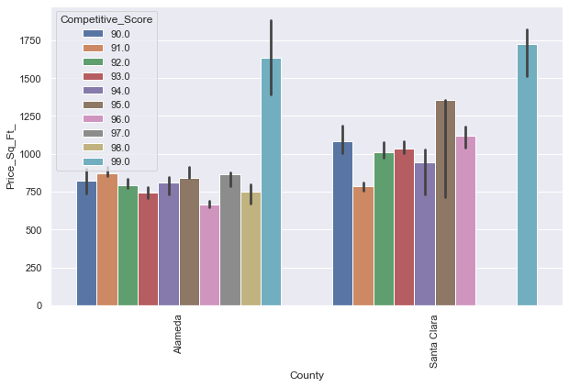
Competitive Score
From the below plot(2), we can understand that there is no strong correlation between competitive score and price per sqft in both the counties.
East/Palo Alto, Dublin, Pleasanton, San Ramon, Los Altos, Newark indicate favorably competitive housing market.
Notes:
The average homes sell for about 10% above list price and go pending in around 10 days.
Hot homes can sell for about 19% above list price and go pending in around 8 days.

Slide 18
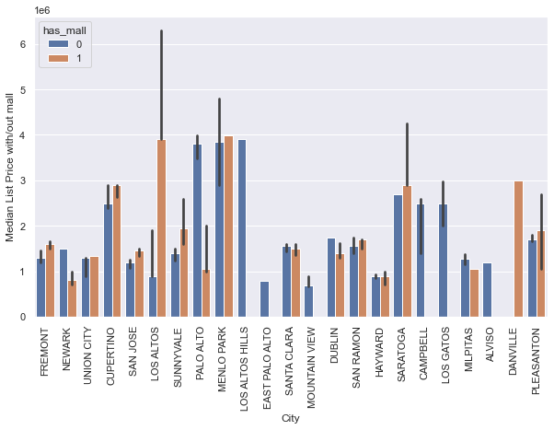
Mall
Having a mall nearby spiked the prices in Fremont, Los Altos, San Jose, Cupertino, Saratoga, Pleasanton.
In Places like Palo Alto, presence of mall did not have significant impact.

Slide 19
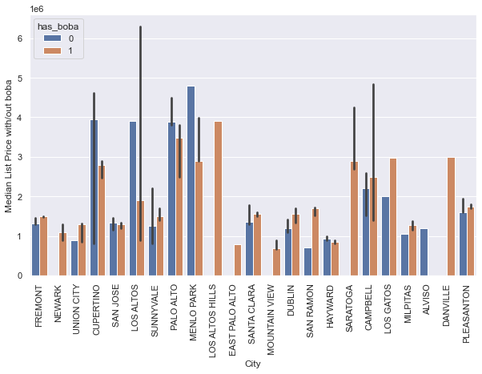
Bubble tea
Having a boba store nearby has shown some good price appreciation in Fremont, Union City, Santa Clara, Pleasanton, Dublin, Sunnyvale, San Ramon, Los Gatos, Campbell and Milpitas.
Looks like there might be some good interest for Boba in Bay area.

Slide 20
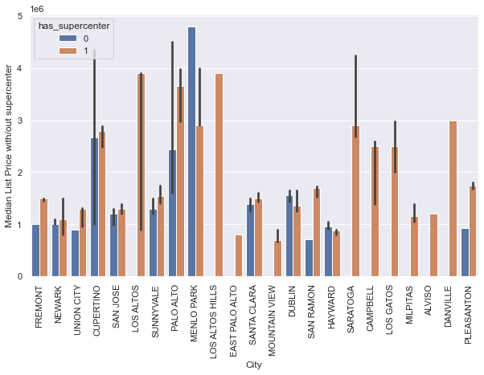
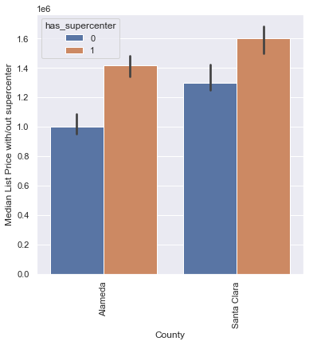
Supermarket
Almost all the cities which are close to a major grocery supermarket have more prices except Hayward, Dublin
At county level, having a major grocery supermarket nearby has more price compared to without a supercenter.

Slide 21
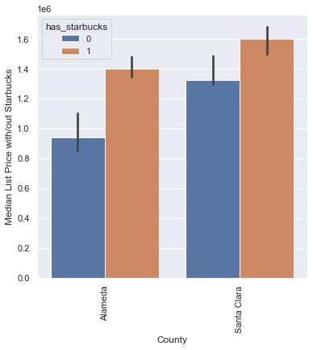
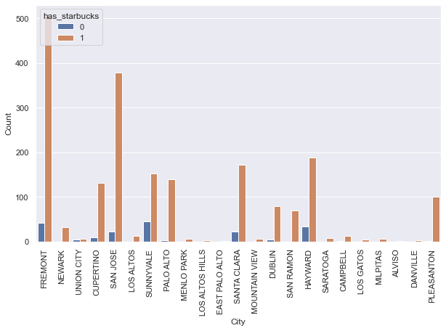
Starbucks
From the 1st plot, at county level, having a Starbucks store nearby near by has more price compared to without a Starbucks.
From the 2nd plot, looks like almost every property has a Starbucks near by in the Bay area.

Slide 22
One hot Encoding
Converting the categorical variables with object data type into category data type.
Introducing dummy variables with binary values (0, 1)
Attributes before introducing dummy variables
'Property_Type’
'County’
'Walk_score_cat’
Attributes after introducing dummy variables
'Property_Type’ - 'Property_Type_Condo', 'Property_Type_Single', 'Property_Type_Townhouse’
'County’: County_Alameda, County_Santa Clara
'Walk_score_cat’ - 'Walk_score_cat_Car Dependent', 'Walk_score_cat_Somewhat Walkable', 'Walk_score_cat_Very Walkable', 'Walk_score_cat_Walkers Paradise'

Slide 23
Prediction

Slide 24
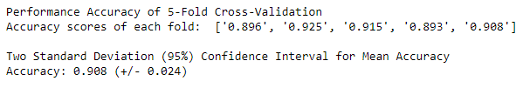
5-Fold cross validation for Multiple linear regression model
Multiple Regression Equation
y=β₀ + β₁x₁+β₂x₂+β₃x₃+…………..β_{n}x_{n} Where y is the dependent variable, β is the intercept and x are the independent variables

Slide 25
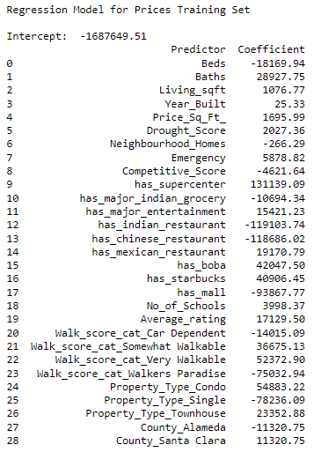
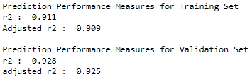
Multiple Regression Equation using sklearn
y=β₀ + β₁x₁+β₂x₂+β₃x₃+…………..β_{n}x_{n} Where y is the dependent variable, β is the intercept and x are the independent variables
In our model, the dependent variable is the list price, and the independent variables are the attributes and amenities.
Identify predictors and outcome of the regression model:
We did not include variables of Address, City, State, zipcode, Counties in the regression because these variables do not affect the model.
R-Squared

Slide 26
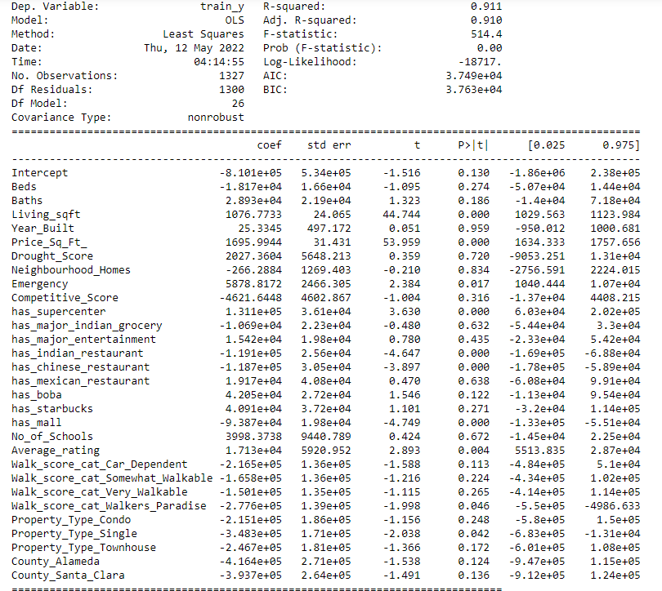
Linear Regression Model using stat models Library
Also performed OLS Linear Regression to identify the best fit model and significant variables for predicting the House prices.
We observed Living Sqft,Price_sq_ft, has_supercenter,has_Indian_restaurant,has_Chinese_rrestaurant,has_mall, average_school_rating, Property_type_single proved to be significant for price prediction.

Slide 27
Conclusion

Slide 28
Conclusion
Factors like presence of supermarkets, malls nearby influence the housing prices
Housing prices vary across different cities in the bay area.
Schools with better ratings influence the house pricing significantly.
Using the scraped features from Redfin, housing prices can be predicted using the regression model built with an R2 of 0.910.
Additional datapoints in future like socio-economic factors from a county/city can be considered for housing price prediction.

Slide 29
Thank you!
Questions?

